Slide 1
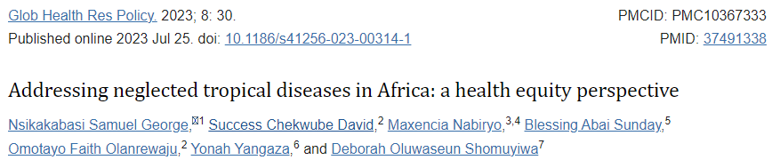
High costs and complicated approval criteria make drug discovery challenging
Less profitable
<1.5% patents for tropical diseases
12 million people with neglected parasitic infections

Slide 2
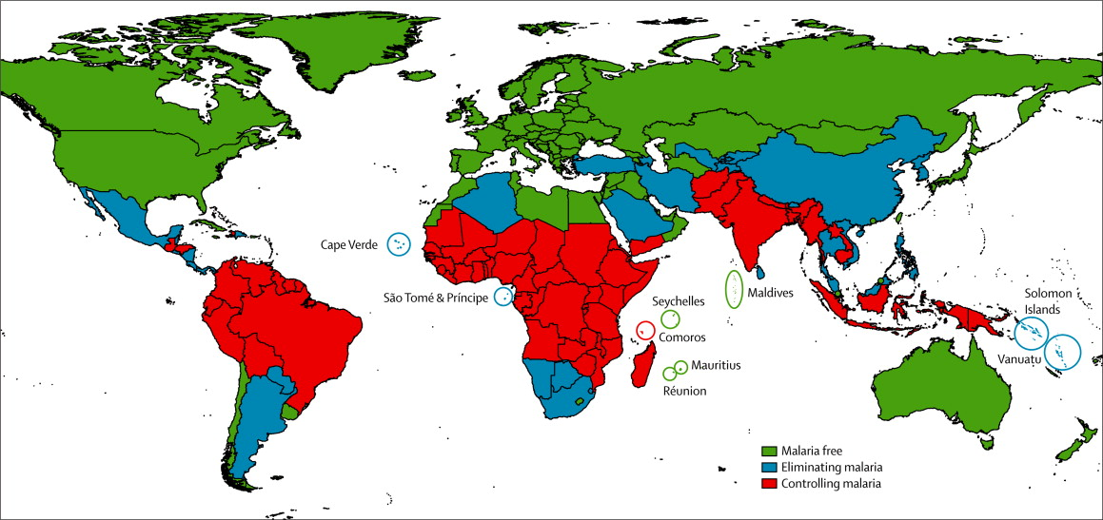
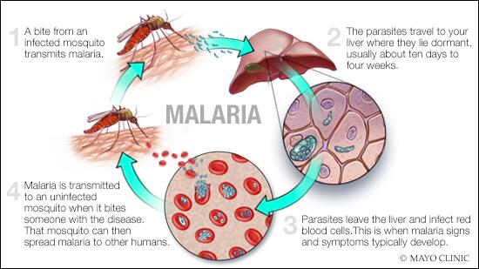
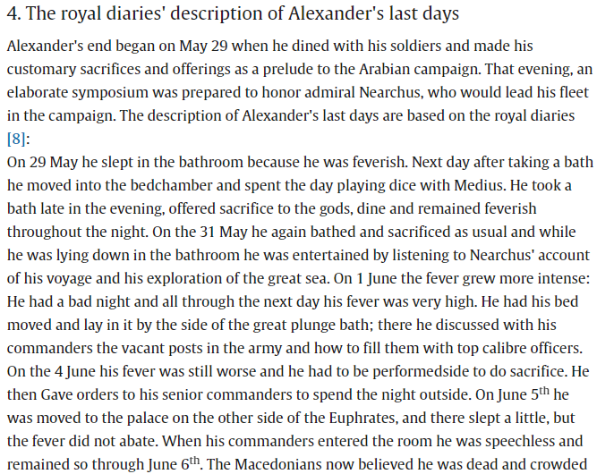
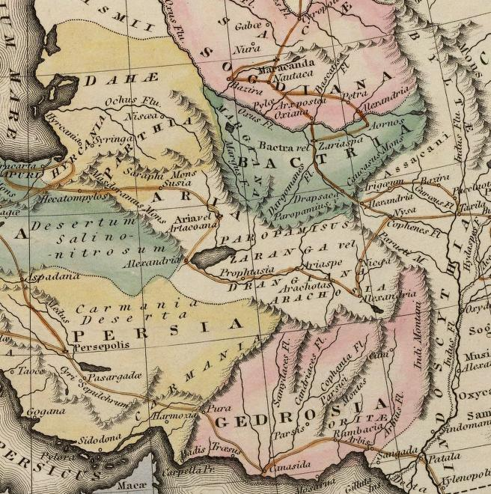
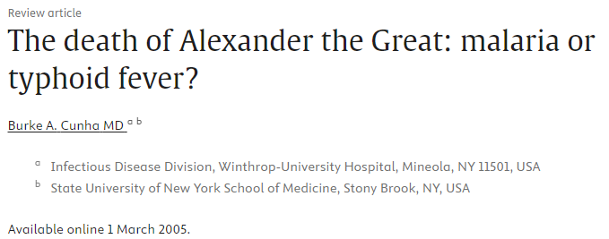
Malaria – Epidemiology/History
2020: 245 million cases; 625,000 deaths
2021: 247 million cases; 619,000 deaths
Ancient Babylon: Gedrosian
Today’s Balochistan (Pakistan)/Iran

Slide 3

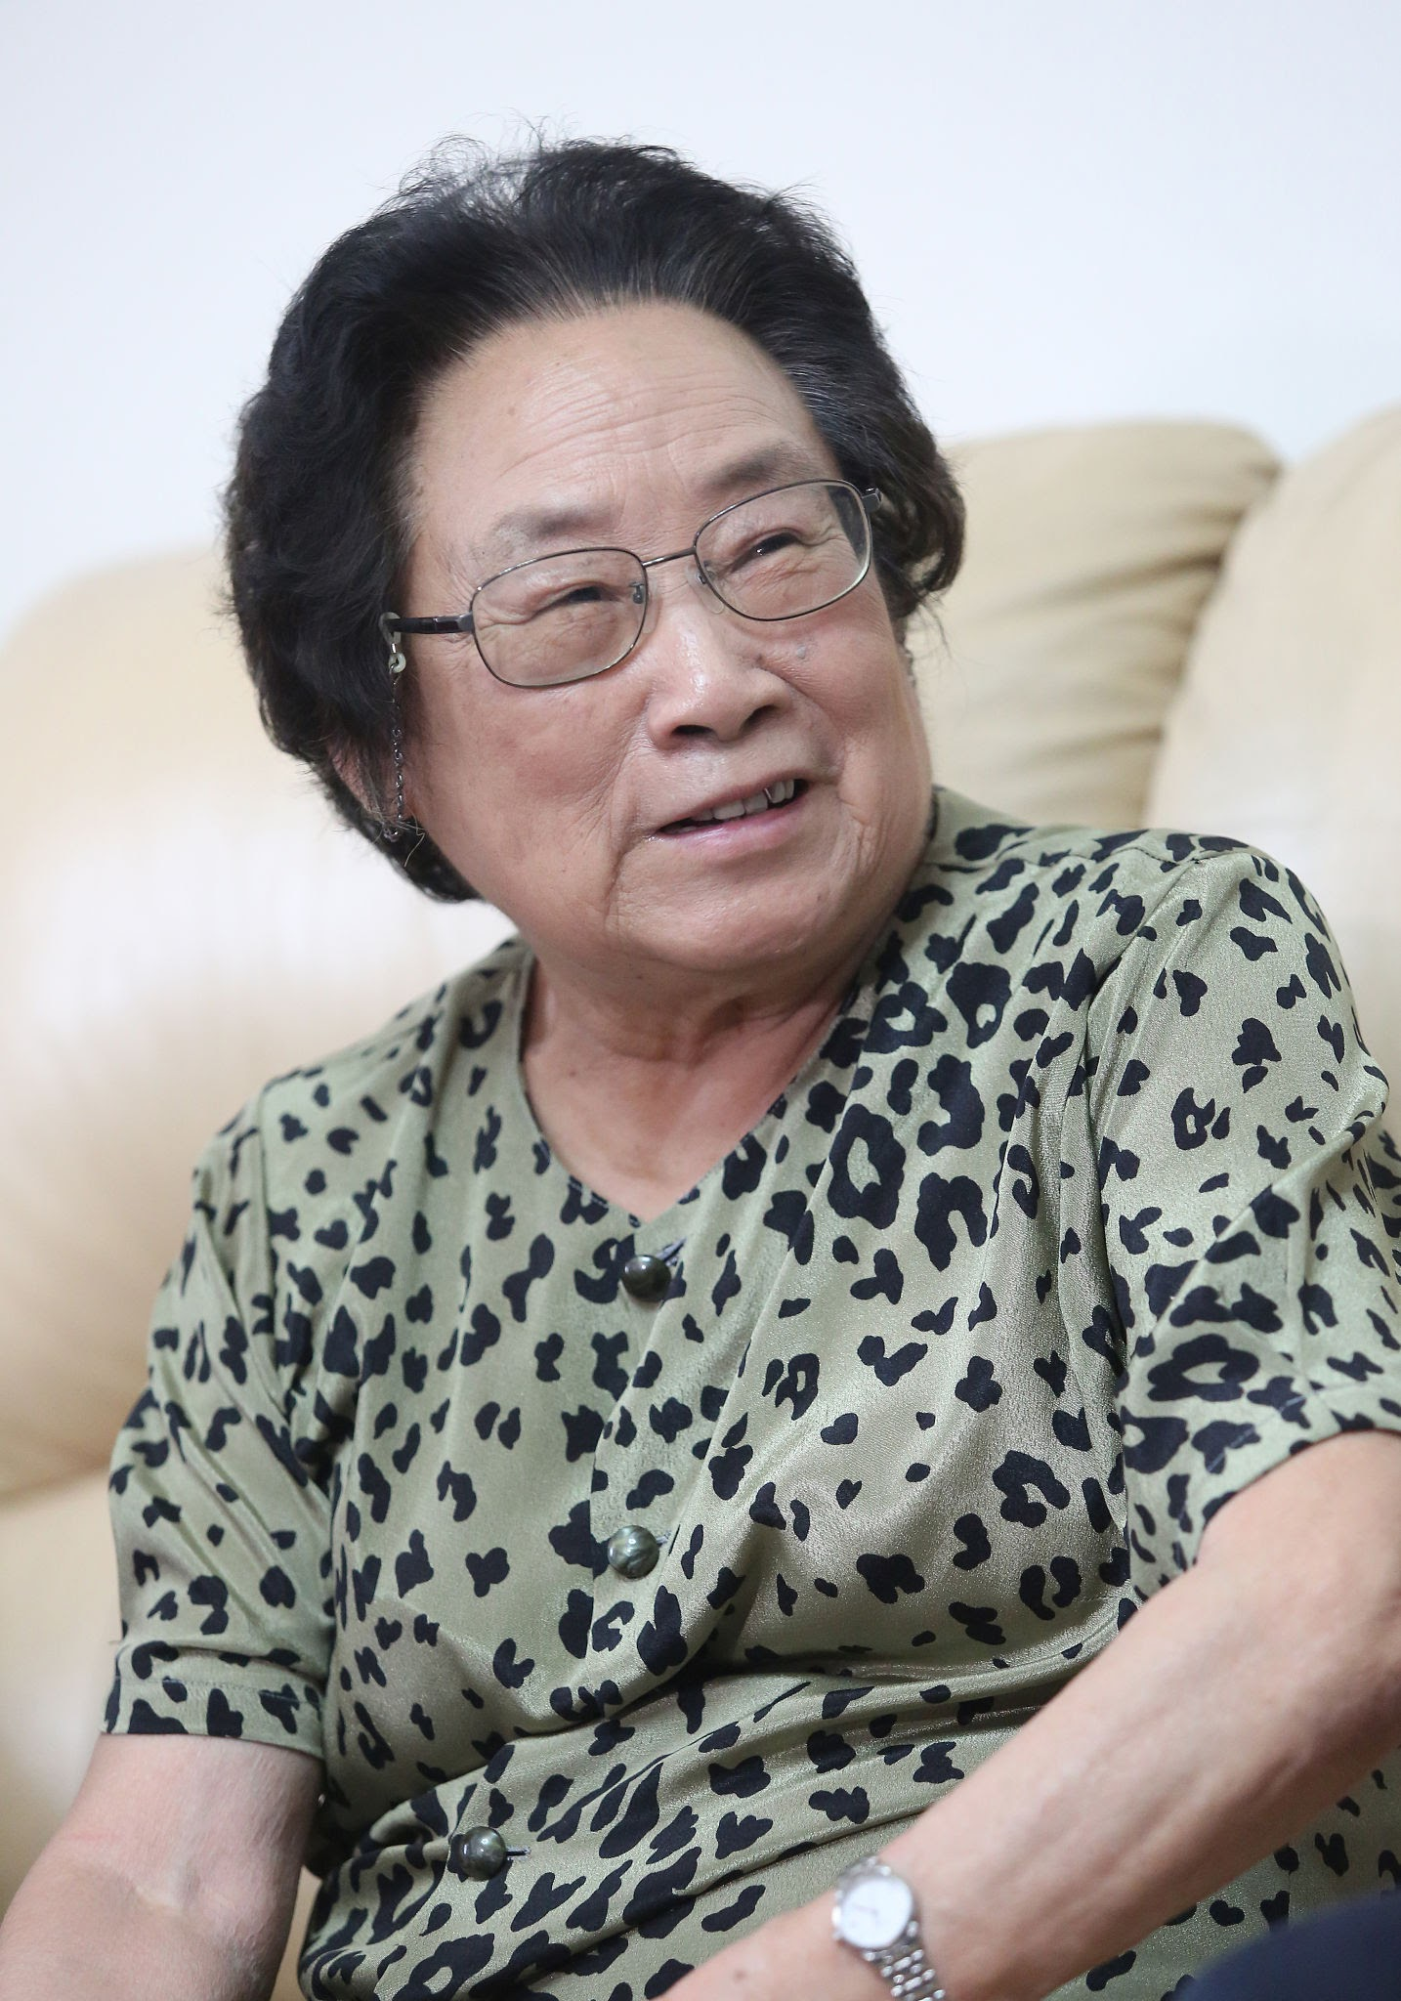
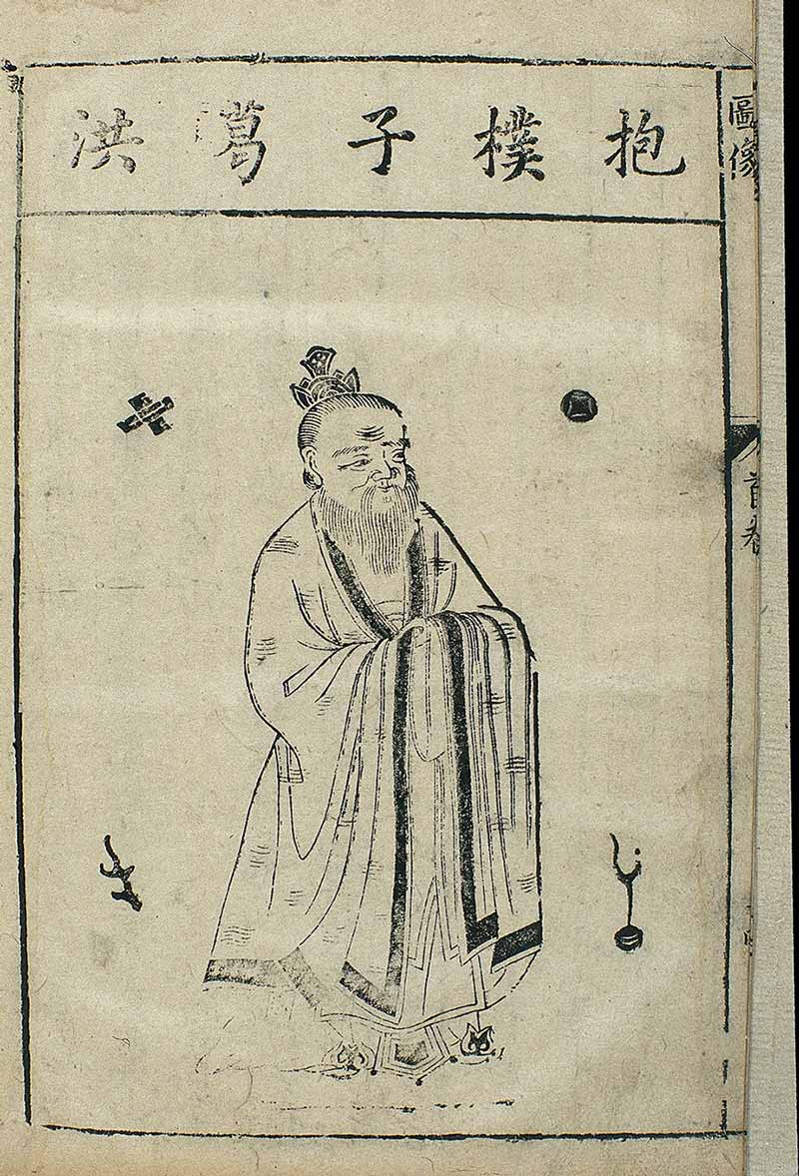
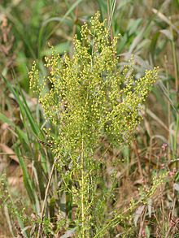
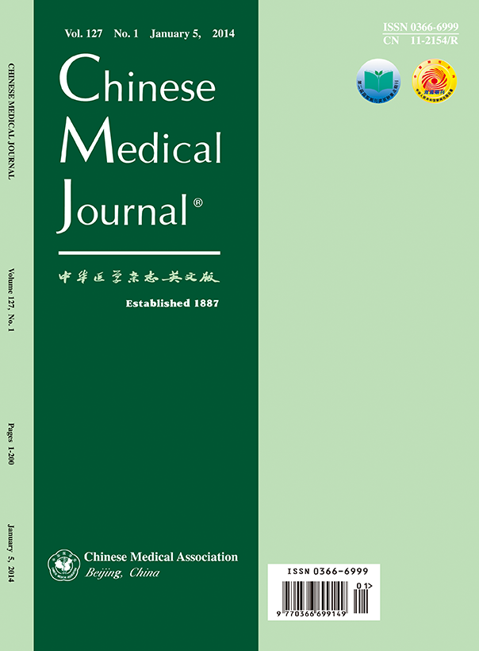

Artemisinin – Discovery
1967 (Vietnam War)
North Vietnamese troops started dying of Malaria
The infection was resistant to Chloroquine
China was approached for help
Tu Youyou (Born 1930)
Academy of traditional Chinese medicine
Studied Chinese medicine against parasitic infection
Project 523 was started to find a cure for Malaria
Ge Hong (c. 283 – 343/364)
Emergency Prescriptions Kept Up One's Sleeve
Sweet wormwood (Artemisia annua)
To treat intermittent fevers
Artemisia annua
Ineffective extract
a handful of qinghao in 0.4 litres of water,
wring out the juice, and drink it all
Published in 1979
200 herbs
380 herbal extracts
2,000 traditional Chinese recipes
240, 000 compounds
were screened worldwide
It took further two decades for
Artemisinin to be recognized by US
and WHO as official treatment for Malaria
due to political mistrust
Late 1990s Novartis filed for Chinese patent
Artemisinin gave 100% success in pre clinical trials
Tu and colleagues tested the compound on themselves for safety
Testing on patients started in Hainan Island
Liao F. Discovery of Artemisinin (Qinghaosu). Molecules. 2009 Dec 21;14(12):5362–6. doi: 10.3390/molecules14125362. PMCID: PMC6254926.

Slide 4
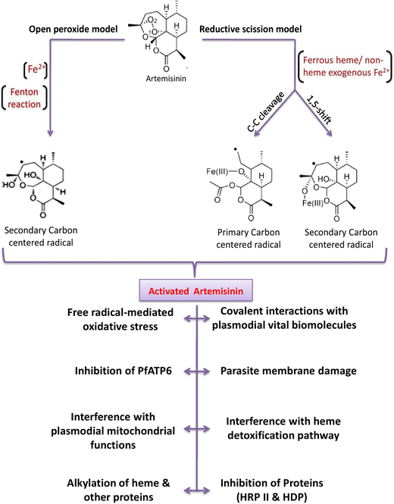
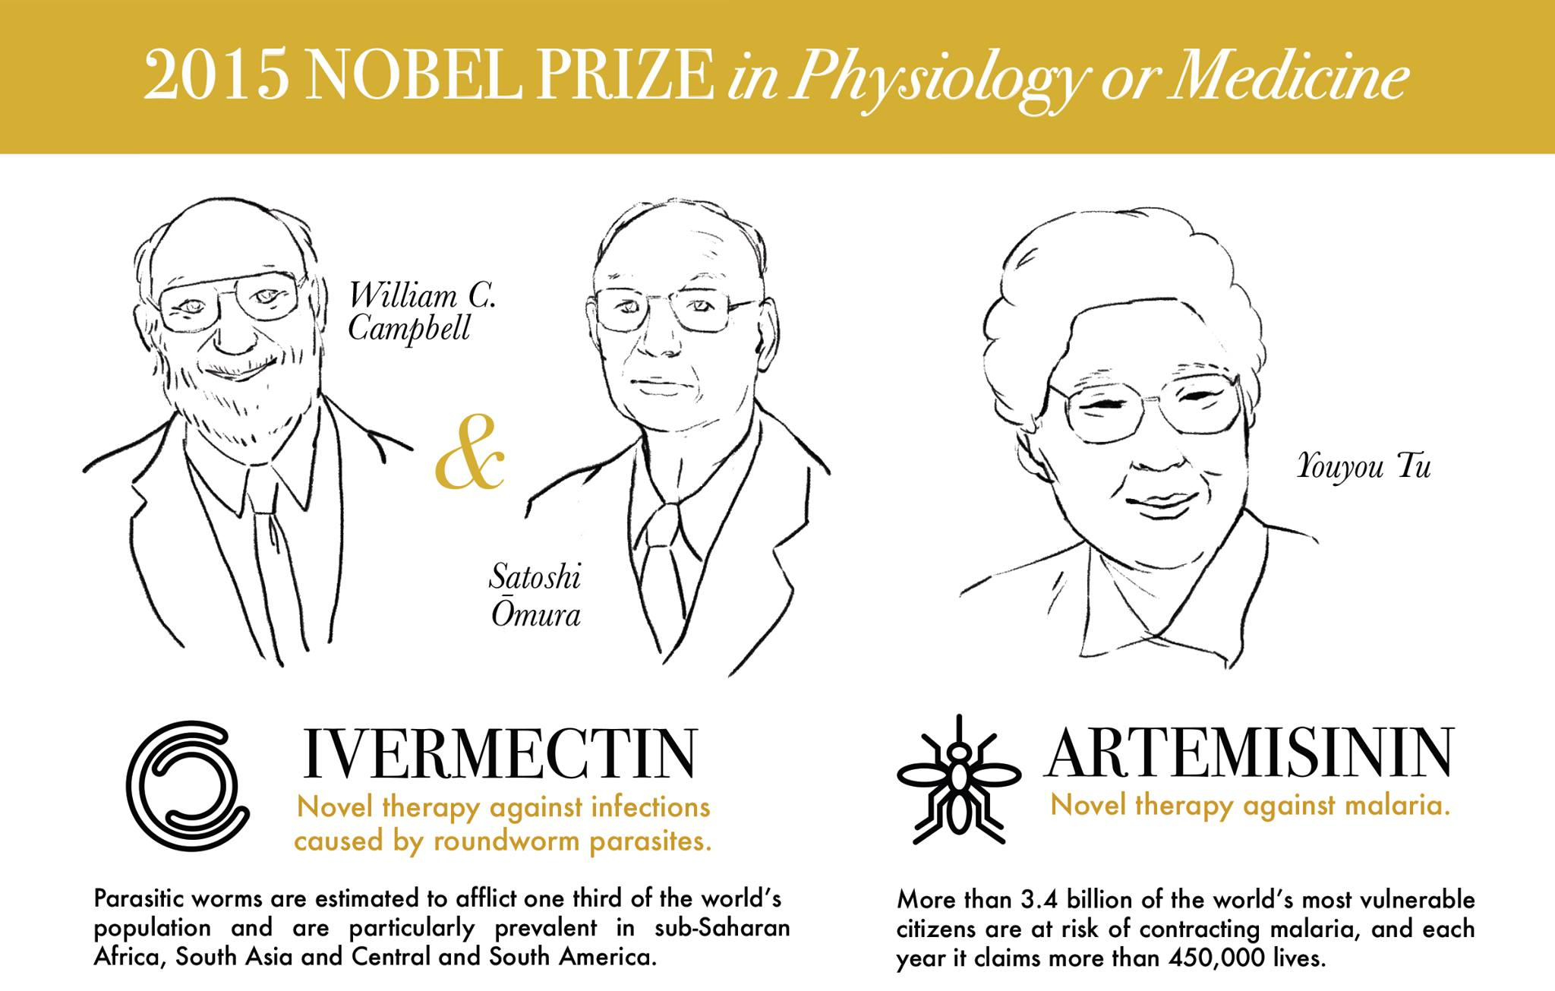
Artemisinin – The Nobel Prize

Slide 5
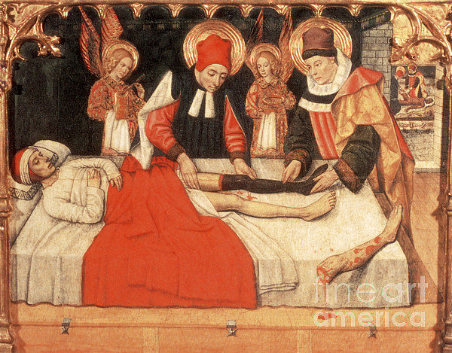
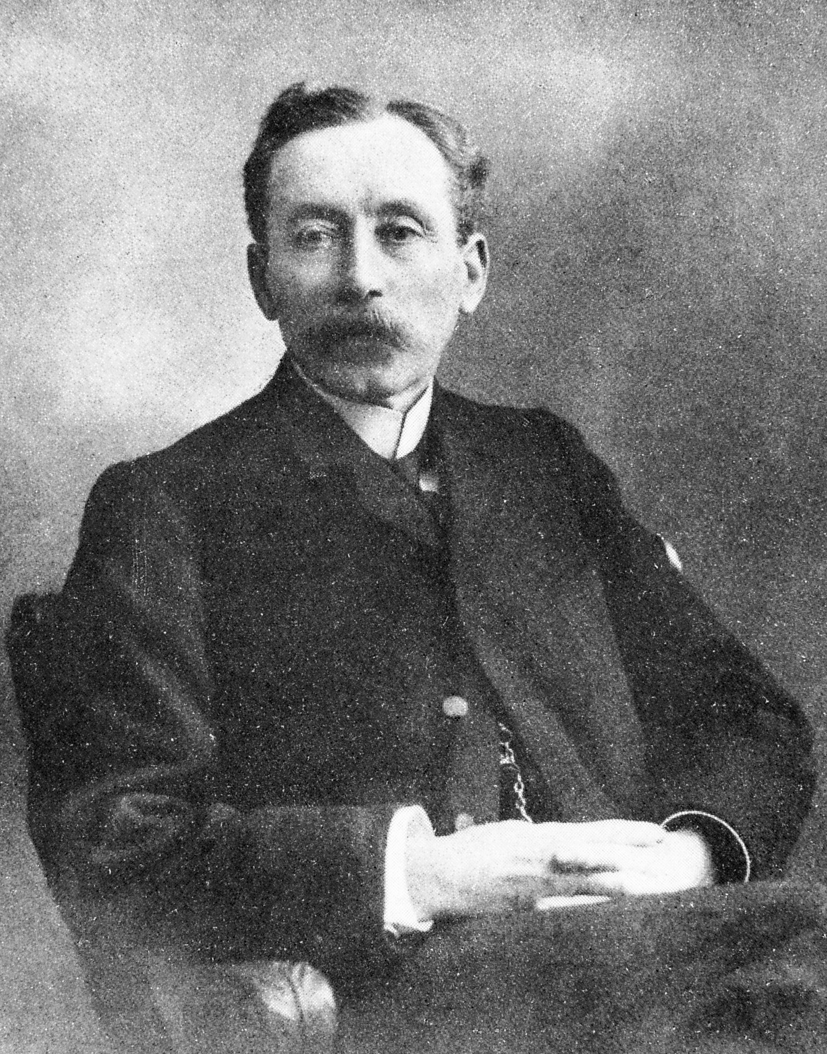
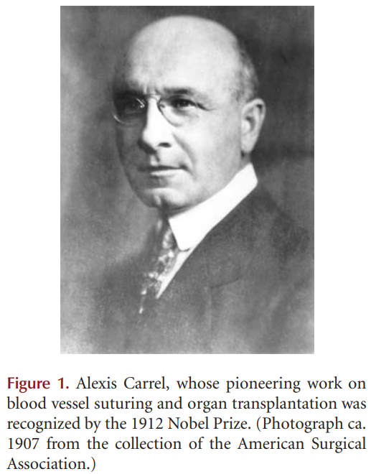

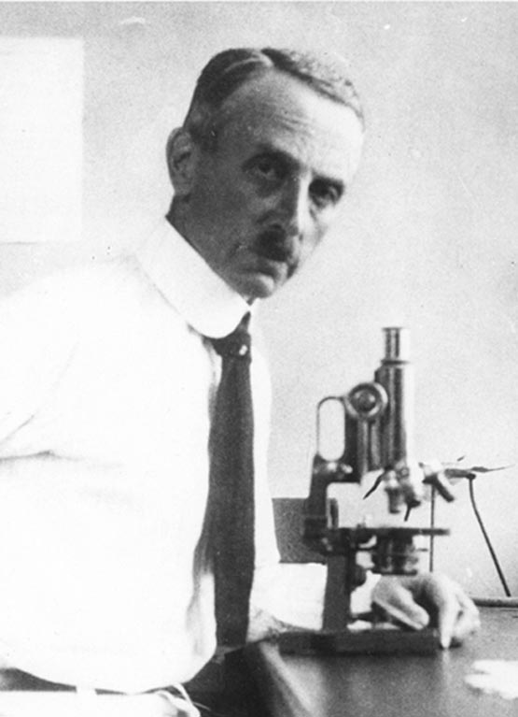
Cyclosporine – History of Transplantation
3rd Century
Cosmos and Damien
Jaques-Louis Reverdin (1842 – 1929)
Showed that thin-grafts (skin) can heal
Leo Loeb (1869 – 1959)
Found that timing of rejection of skin homografts in rats was governed by the extent of genetic disparity of donor and recipient. He also showed
that the lymphocyte was involve
Georg Schöne (1875 – 1960)
Observed that skin homografts fail and subsequent grafts from the same donor failed more rapidly than the first
Notes:
For a long time, proponents of skin homografts refused to admit that they would not work. Success was even claimed for grafts of whole ears and noses. After centuries of sloppy observation and self-deception, the realization crept in that detached (free) skin grafts were useless. In retrospect, the technical failure of even the early autografts was not surprising because at first full-thickness skin grafts were used. These thick grafts never became established because their underlying layer of fat and other tissue prevented revascularization. The first major technical advance (almost a “landmark”) came only in 1869, when Jacques-Louis Reverdin discovered that small, thin (split thickness) grafts would heal (Reverdin 1869).

Slide 6
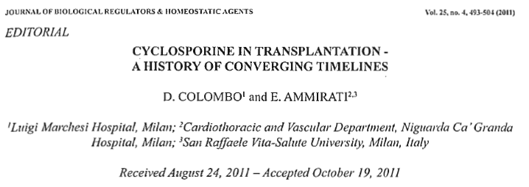
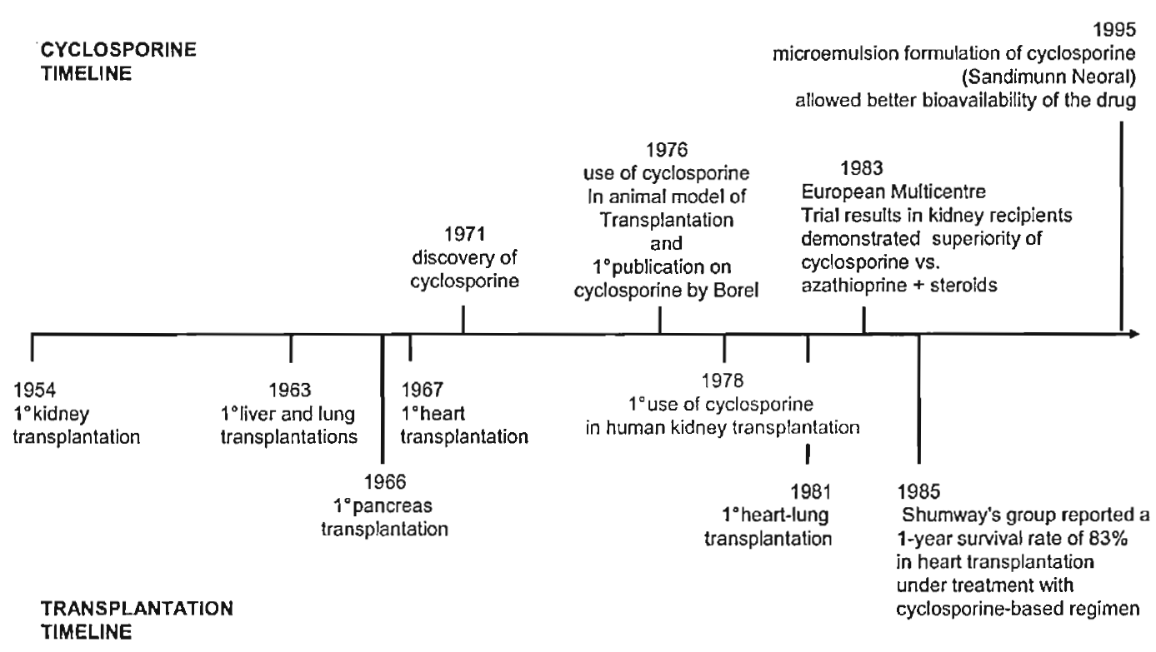
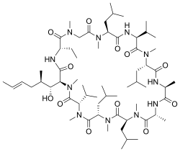
Cyclosporine – Converging Timelines
Azathioprine
Purine synthesis inhibitor
limits the DNA synthesis
for B/T-Cells synthesis
Notes:
Azathioprine is a purine synthesis inhibitor

Slide 7
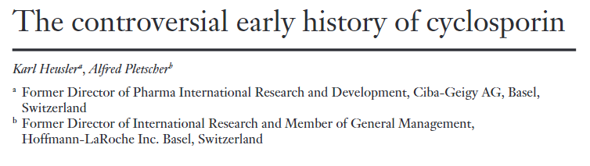
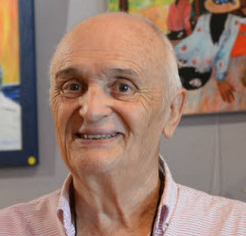
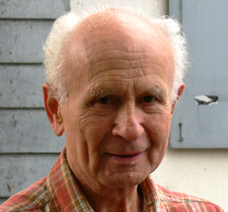

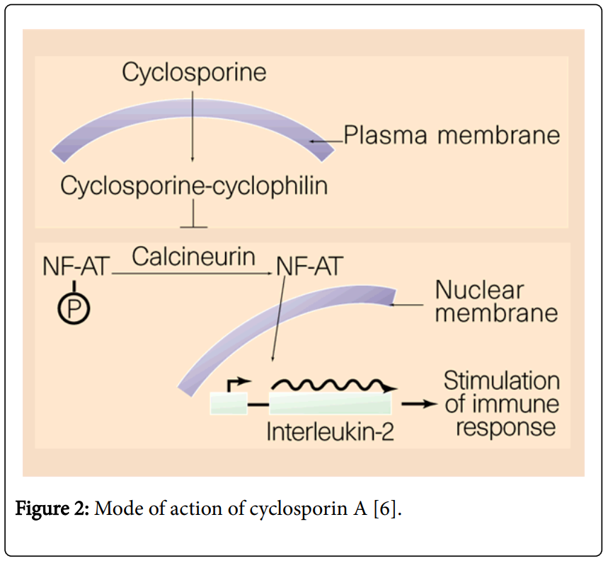
Cyclosporine – Game Changer in Transplantation Medicine
Jean-François Borel (Born 1933)
Hartmann F. Stähelin (1925 – 2011)
approx. 20 yr
to identify mechanism
Goal: Find anti-microbial compound from Natural sources
Antibiotic screening system existed since 1958
Sandoz included immunosuppression assays in their screening
Market size USD 2 B (2021)
Projected USD 6.08 B (2030)
Tolipocladium inflatum – fungus isolated from Norwegian soil (compound 24-556)
“The detection of the interesting biological profile of cyclosporin (immunosuppressionwithout cytotoxic activity) occurred in the very first experiment carried out in the cell pharmacology group of Sandoz. Both Borel and Stähelin contributed towards this crucial experiment. Stähelin and collaborators (especially Lazary) provided the experimental system aimed at detecting an immunosuppressant agent without major cytotoxicity and they also introduced the method (haemagglutination) that made the discovery possible. Furthermore the first experiments on animals were performed in Stähelin’s laboratory, and it was in this laboratory that the clinically important absence of relevant cytotoxic activity was established. Borel’s laboratory performed the haemagglutinin test, which demonstrated the immunosuppressive activity of cyclosporin. His modification of the application schedule may also have contributed to the positive outcome of the experiment.”

